Slide 1
Work(N-m or Joule)
Work W is performed whenever a force acts through a distance.
By definition,
dW = F dl
The work which accompanies a change in volume of a fluid is often encountered in thermodynamics.
A common example is the compression or expansion of a fluid in a cylinder resulting from the movement of a piston.

Slide 2
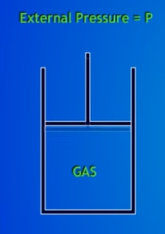
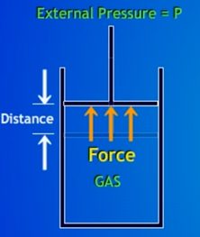
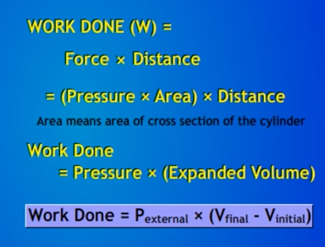
E.g. expansion of an ideal gas in a cylinder having frictionless movable piston

Slide 3


Since A is constant, dW = - PdV^{t}
Integrating,
The minus signs in these equations are made necessary by the sign convention adopted for work.

Slide 4
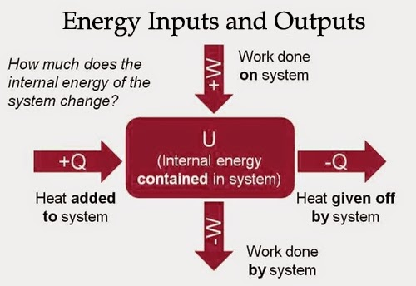

Slide 5
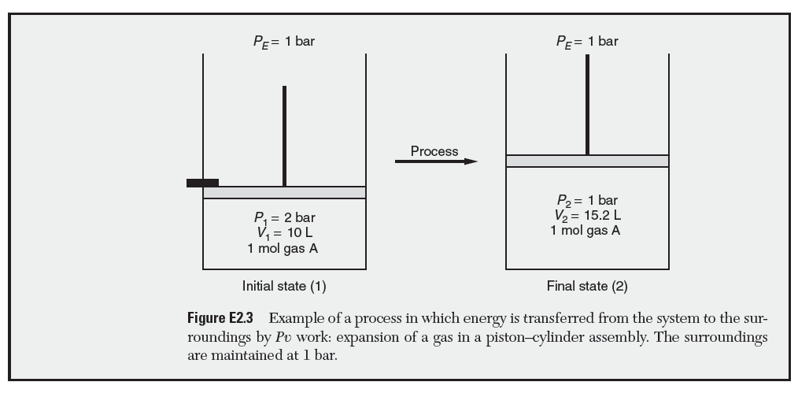

Slide 6
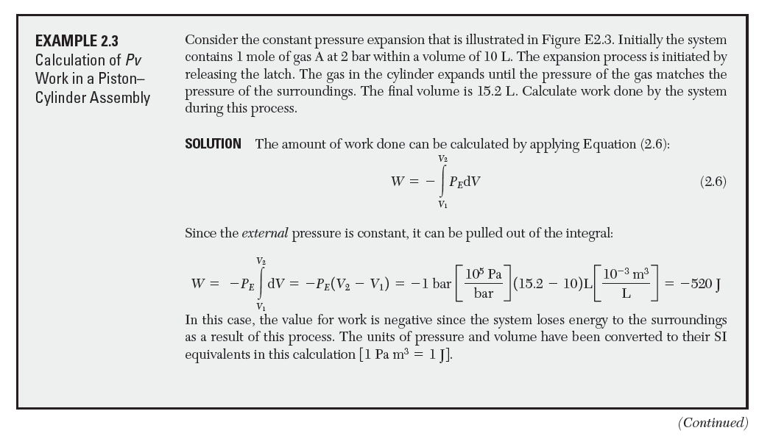

Slide 7
Reversible Processes
A process is reversible if, after the process occurs, the system can be returned to its original state without any net effect on the surroundings.
Reversible process should be carried out very slowly.
Or in other words such processes are carried out in innumerable very small stages such that the process may be reversed at any stage very easily.
For example, if a gas undergoes an expansion process, we must be able to turn the process around at any point and compress it simply by changing the force on the piston by a small amount.
Reversible process should be in equilibrium all through.
Reversible processes yields the maximum amount of work.

Slide 8
Reversible process is actually not feasible but we can approach towards reversibility by carrying out the process very slowly.
These processes represent an idealization. However, in engineering these types of idealizations are often useful.
For example, it is useful to know how much work we could get out of a system if a process could be executed reversibly. This value tells us the best that we could possibly do.
We can then compare how well we really do, and see if it is worth focusing our efforts on improving the process.
Good engineering is as much determining where to focus your resources as it is actual problem solving.

Slide 9
Irreversible Processes
Real processes are not reversible. They have friction and are carried out with finite driving forces. Such processes are irreversible processes.
Irreversible processes cannot be reversed in any way and is not in equilibrium.
The work obtained in an irreversible process is always less than that obtained in the idealization of a reversible process.

Slide 10
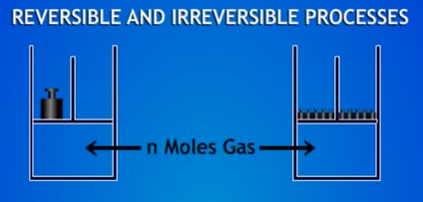
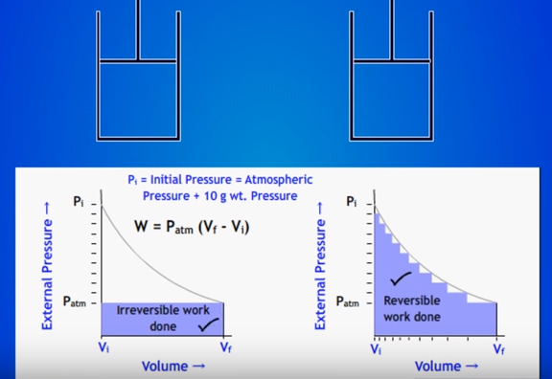

Slide 11
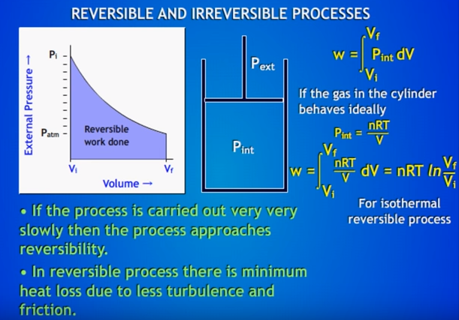

Slide 12
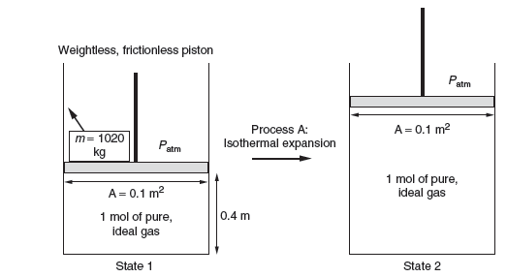

Isothermal expansion of a piston– cylinder assembly
The system contains 1 mole of pure ideal gas. A 1020-kg mass sits on the piston. The surroundings are at atmospheric pressure. The molar volume in state 1 can be found from the area 0.1 m² and the height (0.4 m):

Slide 13


Since the piston is originally at rest, the pressure inside the piston can then be found by a force balance:
Process A is initiated by removing the 1020-kg mass. The pressure of the piston is now greater than that exerted by the surroundings, and the gas within the piston expands.
The expansion process continues until once again the pressures equilibrate.
The piston then comes to rest in state 2 where the pressure is given by:

Slide 14



The ideal gas law can be applied to this isothermal process to give:
The volume of state 2 is then given by:
To find the work,
The negative sign indicates we get 4 kJ of work out of the system from this expansion process.

Slide 15
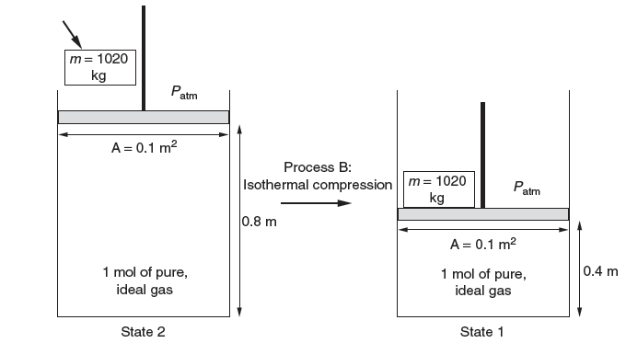
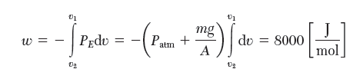
Isothermal compression process

Slide 16
We see it costs us more work to compress the piston back to state 1 than we got from expanding it to state 2.
The net difference in work (8000−4000) = 4000 J in going from state 1 to state 2 and back to state 1 results in a “net effect on the surrounding.”

Slide 17
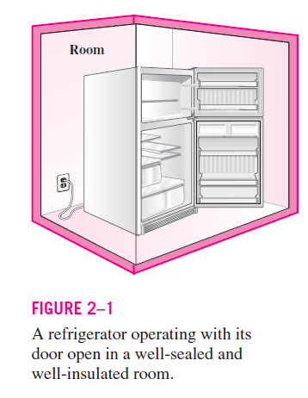
Energy
Law of conservation of energy: Energy cannot be created or destroyed during a process; it can only change from one form to another.
The conservation of energy requires
the energy content of the room to increase
by an amount equal to the amount of the
electrical energy drawn by the refrigerator.
Notes:
the electrical energy is converted into an equivalent
amount of thermal energy stored in the room air
Actually, by “energy conservation” what is
meant is the conservation of the quality of energy, not the quantity. Electricity,
which is of the highest quality of energy, for example, can always be
converted to an equal amount of thermal energy (also called heat). But only
a small fraction of thermal energy, which is the lowest quality of energy, can
be converted back to electricity,

Slide 18
Energy
The ability of body to do work.
Energy can exist in numerous forms such as thermal, mechanical, kinetic, potential, electric, magnetic, chemical, and nuclear, and their sum constitutes the total energy E of a system.
The total energy of a system on a unit mass basis is denoted by e and is expressed as
e = E/m = KJ/Kg

Slide 19
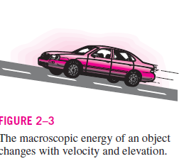
Total energy of a system in two groups:
Macroscopic
Microscopic
The macroscopic forms of energy are those a system possesses as a whole with respect to some outside reference frame, such as kinetic and potential energies.
i.e., kinetic energy depends on velocity with respect to the surroundings, and potential energy depends on elevation with respect to a datum level.

Slide 20
The microscopic forms of energy are those related to the molecular structure of a system and the degree of the molecular activity.
They are independent of outside reference frames.
The sum of all the microscopic forms of energy is called the internal energy of a system and is denoted by U.
The internal energy is also associated with various binding forces between the molecules of a substance, between the atoms within a molecule, and between the particles within an atom and its nucleus.

Slide 21
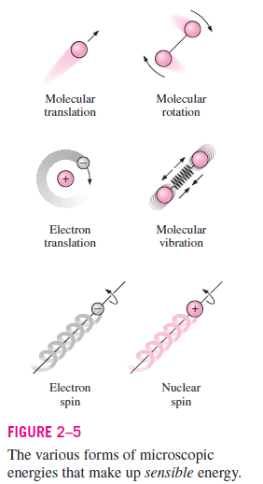
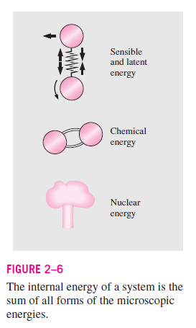

Slide 22
Sensible energy: exchange of heat changes the temperature of the body or system. The portion of the internal energy of a system associated with the kinetic energies of the molecules
The internal energy associated with the phase of a system is called the latent energy
The internal energy associated with the atomic bonds in a molecule is called chemical energy.
The tremendous amount of energy associated with the strong bonds within the nucleus of the atom itself is called nuclear energy.
The mechanical energy can be defined as the form of energy that can be converted to mechanical work completely and directly by an ideal mechanical device such as an ideal turbine.

Slide 23
Mechanical energy
It can be defined as the form of energy that can be converted to mechanical work completely and directly by an ideal mechanical device such as an ideal turbine.
Kinetic and potential energies are the familiar forms of mechanical energy.
A pump transfers mechanical energy to a fluid by raising its pressure, and a turbine extracts mechanical energy from a fluid by dropping its pressure.
Therefore, the pressure of a flowing fluid is also associated with its mechanical energy.

Slide 24
In fact, the pressure unit ‘Pa’ is equivalent to
Pa = N/m² = N · m/m³ J/m³, which is energy per unit volume.
and the product Pv or its equivalent P/ρ has the unit J/kg, which is energy per unit mass.
Note that pressure itself is not a form of energy.
But a pressure force acting on a fluid through a distance produces work, called flow work.

Slide 25

Flow work is expressed in terms of fluid properties, and it is convenient to view it as part of the energy of a flowing fluid which is called flow energy.
Therefore, the mechanical energy of a flowing fluid can be expressed on a unit mass basis as
where P/ρ is the flow energy, V ²/2 is the kinetic energy, and gz is the potential energy of the fluid, all per unit mass.

Slide 26



It can also be expressed in rate form as
where is the mass flow rate of the fluid.
There are four common measures of flow:
The measures of flow are interrelated:
where ℳ is molar mass and A is the cross-sectional area for flow.

Slide 27



Importantly, mass and molar flow rates relate to velocity:
Where A is the cross-sectional area of a conduit, and ρ is specific or molar density.
Change in mechanical energy of a fluid during incompressible flow (ρ = constant) becomes
Therefore, the mechanical energy of a fluid does not change during flow if its pressure, density, velocity, and elevation remain constant.

Slide 28

Kinetic energy (N-m or J)
Kinetic energy, E_{K} is the energy associated with the motion of the system as a whole.
or
The energy that a system possesses as a result of its motion relative to some reference frame is called kinetic energy (KE).
For example, an object of mass ‘m’ moving at velocity ‘V’ has a kinetic energy given by:

Slide 29


When a body of mass m, acted upon by a force F, is displaced a distance ‘dl, during a differential interval of time dt, the work done is given by Eq.
acceleration is a ≡ du/dt, where u is the velocity of the body. Thus,
velocity is u = dl/dt, the expression for work becomes:
dW = mu du
Notes:
The energy that a system possesses as a result of its motion
relative to some reference frame is called kinetic energy (KE).

Slide 30


This equation may now be integrated for a finite change in velocity from u₁ to u₂:
This is a kinetic energy, a term introduced by Lord Kelvin in 1856. Thus, by definition,
E_{K} ≡1/2mu ²

Slide 31

Potential Energy
The energy possessed by a body by virtue of its position relative to others
or
The potential energy, E_{P}, is the energy associated with position of the system in a potential field.
For example, an object in the Earth’s gravitational field has a potential energy given by:

Slide 32

If a body of mass m is raised from an initial elevation z₁ to a final elevation z₂, an upward force at least equal to the weight of the body must be exerted on it, and this force must move through the distance z₂ – z₁.
Since the weight of the body is the force of gravity on it, the minimum force required is given by Newton's law:
where g is the local acceleration of gravity.
The minimum work required to raise the body is the product of this force and the change in elevation:
W = F (z₂ - z₁) = mg (z₂ - z₁)

Slide 33


The work done on a body in elevating it is said to produce a change in its potential energy:
Thus potential energy is defined by:

Slide 34

Energy Conservation
If a body is given energy when it is elevated, then the body conserves or retains this energy until it performs the work of which it is capable.
An elevated body, allowed to fall freely, gains in kinetic energy what it loses in potential energy so that its capacity for doing work remains unchanged.
For a freely falling body this means that:

Slide 35
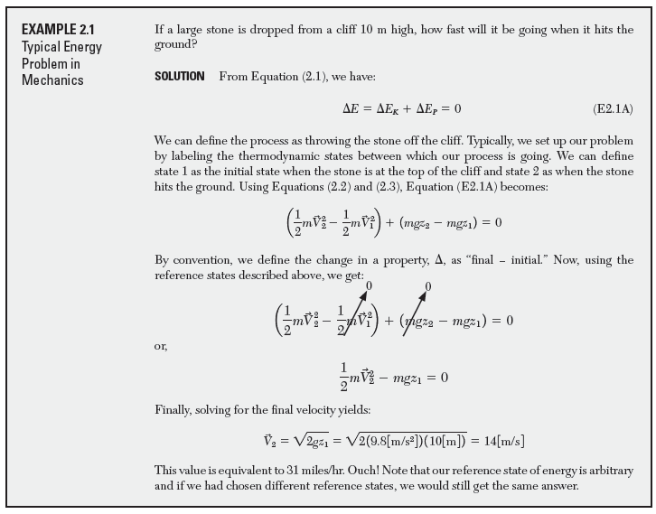

Slide 36
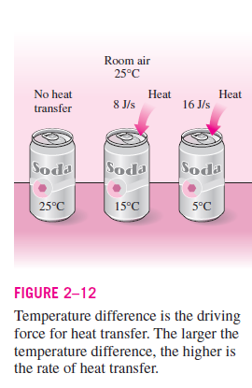
Heat
Heat is defined as the form of energy that is transferred between two systems (or a system and its surroundings) by virtue of a temperature difference.

Slide 37
Heat always flows from a higher temperature to a lower one.
Rate of heat transfer from one body to another is proportional to the temperature difference between the two bodies;
In the thermodynamic sense, heat is never regarded as being stored within a body. Like work, it exists only as energy in transit from one body to another, or between a system and its surroundings.
When energy in the form of heat is added to a body, it is stored not as heat but as kinetic and potential energy of the atoms and molecules making up the body.

Slide 38
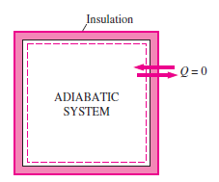
A process during which there is no heat transfer is called an adiabatic process.
There are two ways a process can be adiabatic: Either the system is well insulated so that only a negligible amount of heat can pass through the boundary,
or
Both the system and the surroundings are at the same temperature and therefore there is no driving force (temperature difference) for heat transfer.

Slide 39
An adiabatic process should not be confused with an isothermal process.
Even though there is no heat transfer during an adiabatic process, the energy content and thus the temperature of a system can still be changed by other means such as work.
As a form of energy, heat has energy units, kJ (or Btu) being the most common one.
British thermal unit (commonly known as thermo chemical Btu) was long defined as 1/180th quantity of heat which when transferred to one pound mass of water raised its temperature from ice-point or 32 (F) to steam-point or 212 (F) at standard atmospheric pressure.

Slide 40

Likewise the calorie (commonly known as thermo chemical calorie) , was defined as 1/100th quantity of heat which when transferred to one kilogram mass of water raised its temperature from 0 to 100°C (273.15 to 373.15 K) at standard atmospheric pressure.
The amount of heat transferred during the process between two states (states 1 and 2) is denoted by Q₁₂, or just Q.
Heat transfer per unit mass of a system is denoted q and is determined from

Slide 41
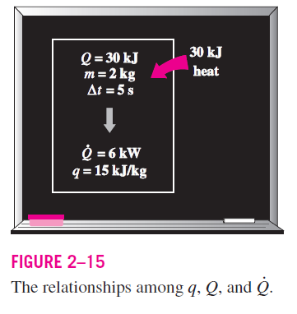

Rate of heat transfer: The amount of heat transferred per unit time
The heat transfer rate is denoted where
the overdot stands for the time derivative,
or “per unit time.”
The heat transfer rate has the unit kJ/s,
which is equivalent to kW.
When varies with time, the amount of
heat transfer during a process is determined by integrating over the time interval of the process:

